Slide 1
Analysis Of SAS Software Structure
App.xaml.cs
MainWindow.xaml.cs
AutoTestResWindow.xaml.cs
CharWindow.xaml.cs
CmdScriptWindow.xaml.cs
CmdWindow.xaml.cs
DbmManagement.xaml.cs
Log.cs
Daqcomm.cs
SasComm.cs
SasFixed.cs
SasList.cs
SasSpin.cs
SasTable.cs
SasComm_TLM.cs
TimeoutMsg.xaml.cs

Slide 2
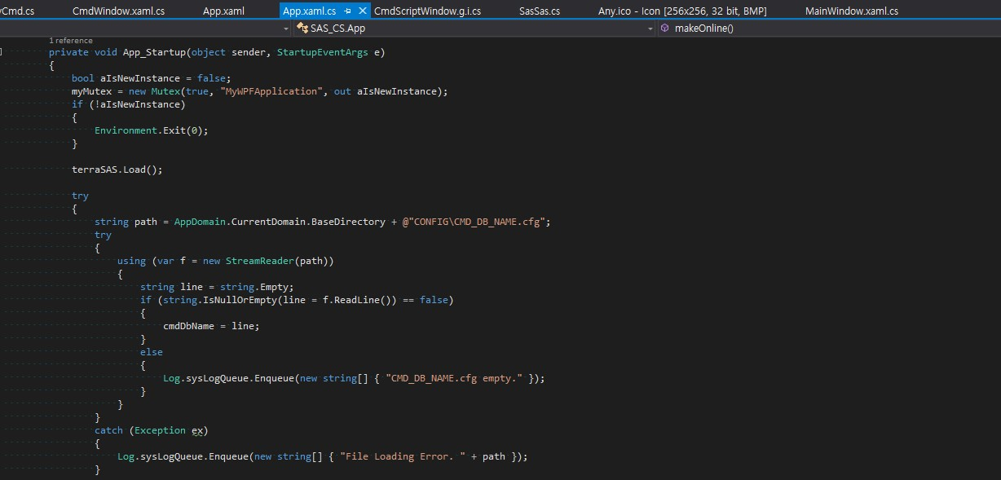
1. App.xaml.cs

Slide 3
1. App.xaml.cs
Application Main Routine (StartUp)
App_Startup
  Read Command/Telemetry Database File (xlsx) and Build Command/Telemetry Structure
  Initialize Telemetry [ initTLM() ]
  Create/Initialize Main Window
    mainWindow = new MainWindow();
    mainWindow.Show();
  Establish/Initialize ITOS Connection
    itosComm = new ItosComm();
    itosComm.start();

Slide 4
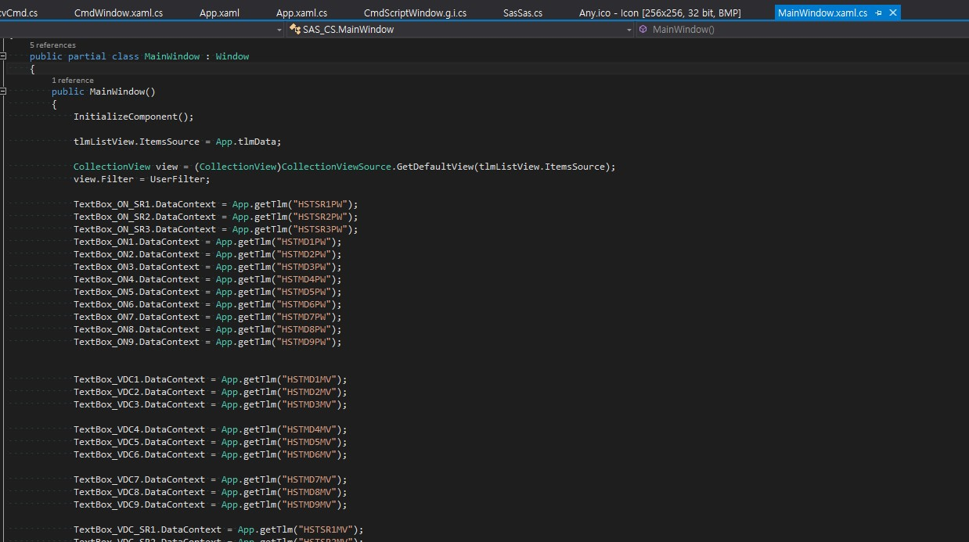
2. MainWindow.xaml.cs

Slide 5
2. MainWindow.xaml.cs
Load all component of main window [ InitializeComponent() ]
Initialize TextBox and ListBox (TLM 등)
  TextBox_ON_SR1.DataContext = App.getTlm("HSTSR1PW");
Button Click시 동작 함수 규정 [ Button_xxx_Click() ]
  private void Button_Cmd_Click(object sender, RoutedEventArgs e)

Slide 6
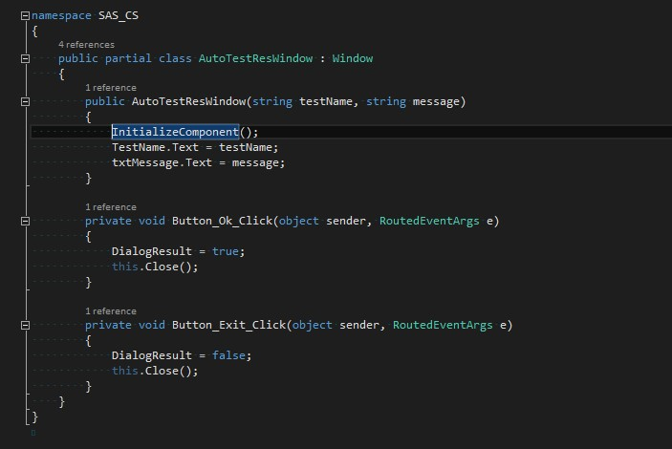
3. AutoTestResWindow.xaml.cs

Slide 7
3. AutoTestResWindow.xaml.cs
AutoTestResWindow 화면 구성
Button Click시 동작 함수 규정 [ Button_xxx_Click() ]
  private void Button_Ok_Click(object sender, RoutedEventArgs e)

Slide 8
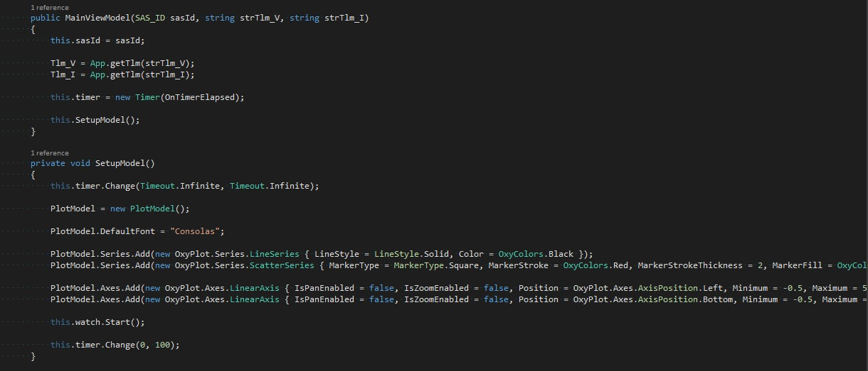
4. ChartWindow.xaml.cs

Slide 9
4. ChartWindow.xaml.cs
V/I Telemetry 설정
  Tlm_V = App.getTlm(strTlm_V);
  Tlm_I = App.getTlm(strTlm_I);
Draw Graph
  this.SetupModel();

Slide 10
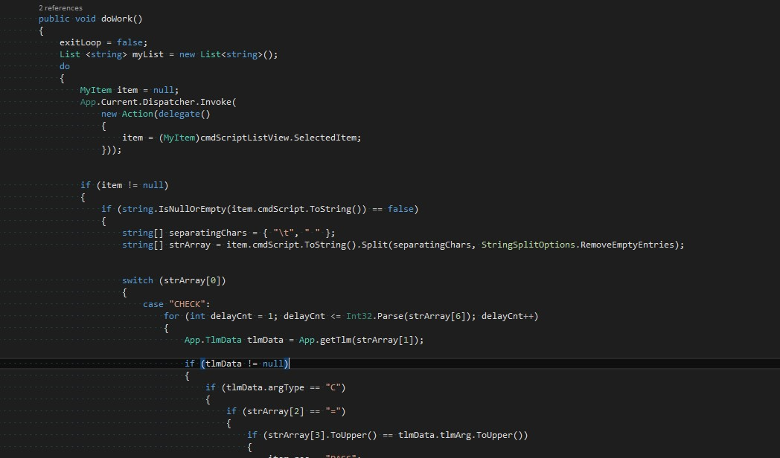
5. CmdScriptWindow.xaml.cs

Slide 11
5. CmdScriptWindow.xaml.cs
CmdScriptWindow 초기화
Script Check / Write
  public void doWork()
Button Click시 동작 함수 규정 [ Button_xxx_Click() ]
  private void Button_Click_2(object sender, RoutedEventArgs e)

Slide 12
6. CmdWindow.xaml.cs

Slide 13
6. CmdWindow.xaml.cs
CmdWindow 초기화
  CollectionView view = (CollectionView)CollectionViewSource.GetDefaultView(cmdListView.ItemsSource);
  view.Filter = UserFilter;
  2. ObservableCollection<App.TlmData> tlmData = new ObservableCollection<App.TlmData>();
Button Click시 동작 함수 규정 [ Button_xxx_Click() ]
  private void Button_exec_Click(object sender, RoutedEventArgs e)
Mouse Double Click 함수 규정 [xxx_MouseDoubleClick() ]
  private void tlmListView_MouseDoubleClick(object sender, MouseButtonEventArgs e)

Slide 14
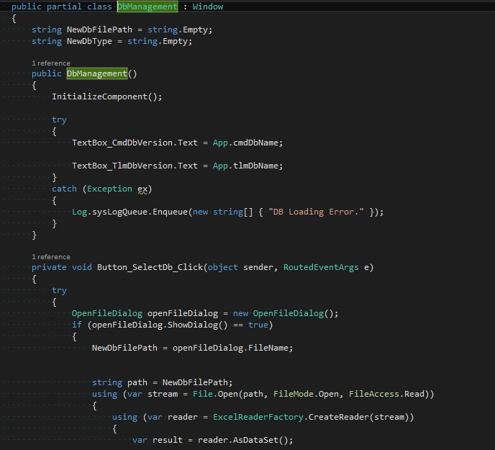
7. DbManagement.xaml.cs

Slide 15
7. DbManagement.xaml.cs
Select CMD Database
  TextBox_CmdDbVersion.Text = App.cmdDbName;
Select TLM DataBase
  TextBox_TlmDbVersion.Text = App.tlmDbName;
Button Click시 동작 함수 규정 [ Button_xxx_Click() ]
  private void Button_SelectDb_Click(object sender, RoutedEventArgs e)
  Import Database

Slide 16
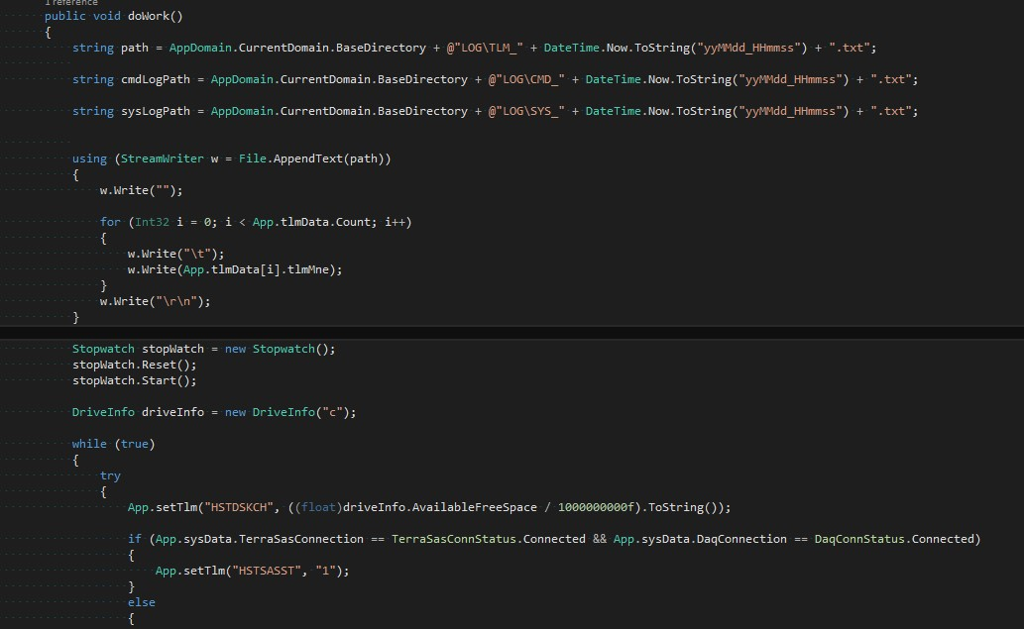
8. Log.cs

Slide 17
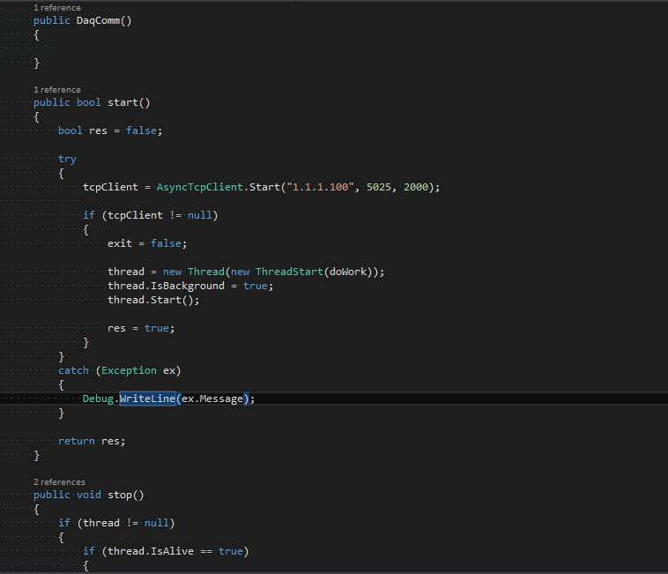
9. DaqComm.cs

Slide 18
9. DaqComm.cs
Establish connection to DAQ device
  static public bool checkConnection()
DAQ Device와 명령어/응답 송수신 및 처리
  public void doWork()
    public void cmd(NetworkStream ns, string cmdStr)
    public Tuple<bool, string> cmd_withResp(NetworkStream ns, string cmdStr)

Slide 19
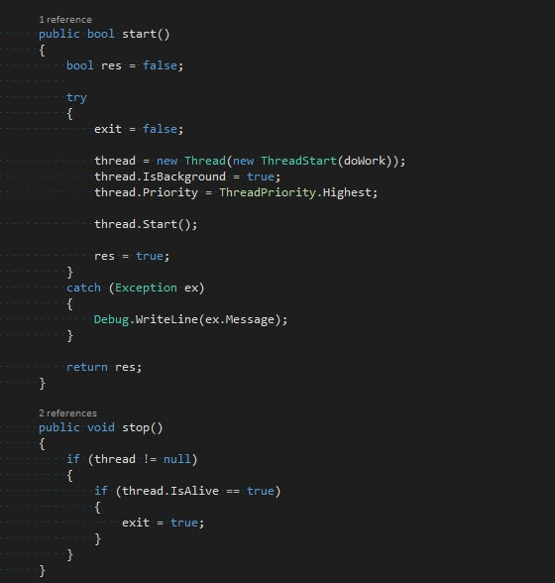
10. SasComm.cs

Slide 20
10. SasComm.cs
SAS Device와의 연결
  App.sysData.TerraSasConnection = TerraSasConnStatus.Connected;
Command 처리
  public void cmdProcessor()
    public void CmdProcessor_Md(string[] strArray)
    public void CmdProcessor_Group(string[] strArray)
명령어에 따라 알맞은 Simluation 수행
  public void CmdProcessor_Md(string[] strArray)
  sasList.DoSimTransition();
  sasSpin.DoSimTrasnsition();

Slide 21
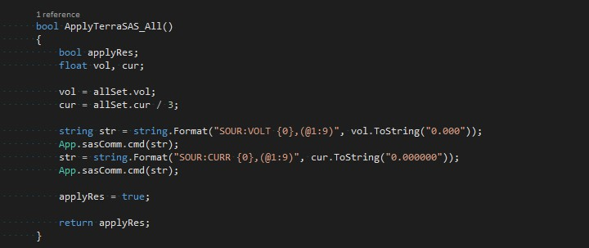
11. SasFixed.cs

Slide 22
11. SasFixed.cs
Command 처리
  public void CmdProcessor(string[] strArray)
  public void CmdProcessor_All(string[] strArray)
  public void CmdProcessor_Md(string[] strArray)
  public void CmdProcessor_Sr(string[] strArray)
SAS Device 통신/제어
  bool ApplyTerraSAS_All()
  bool ApplyTerraSAS_Sr(int srIdx)
  bool ApplyTerraSAS_Md(int mdIdx)

Slide 23
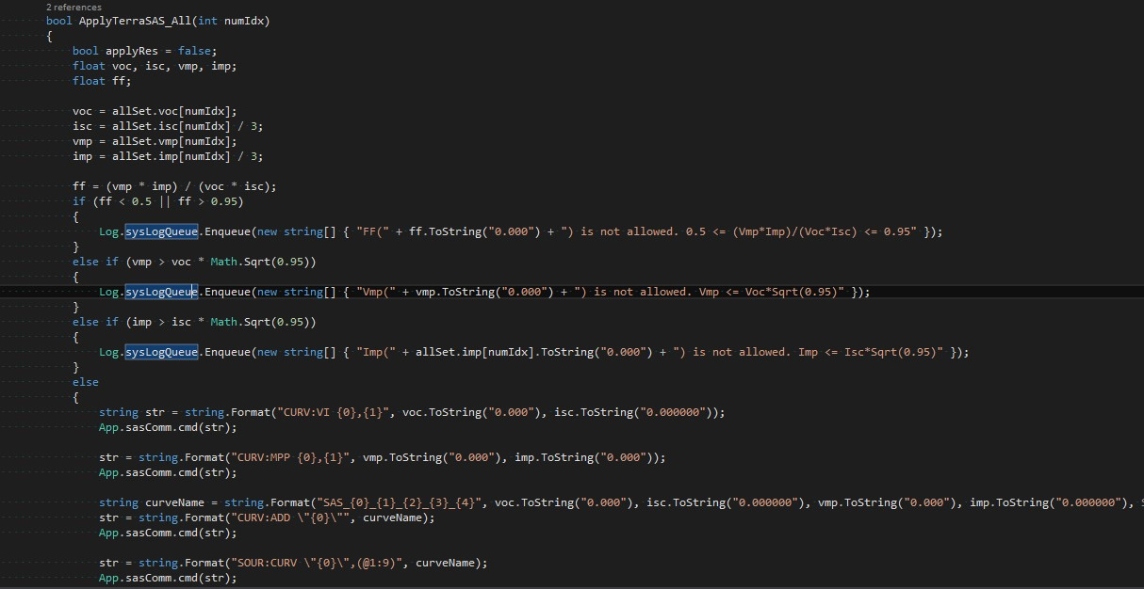
12. SasList.cs

Slide 24
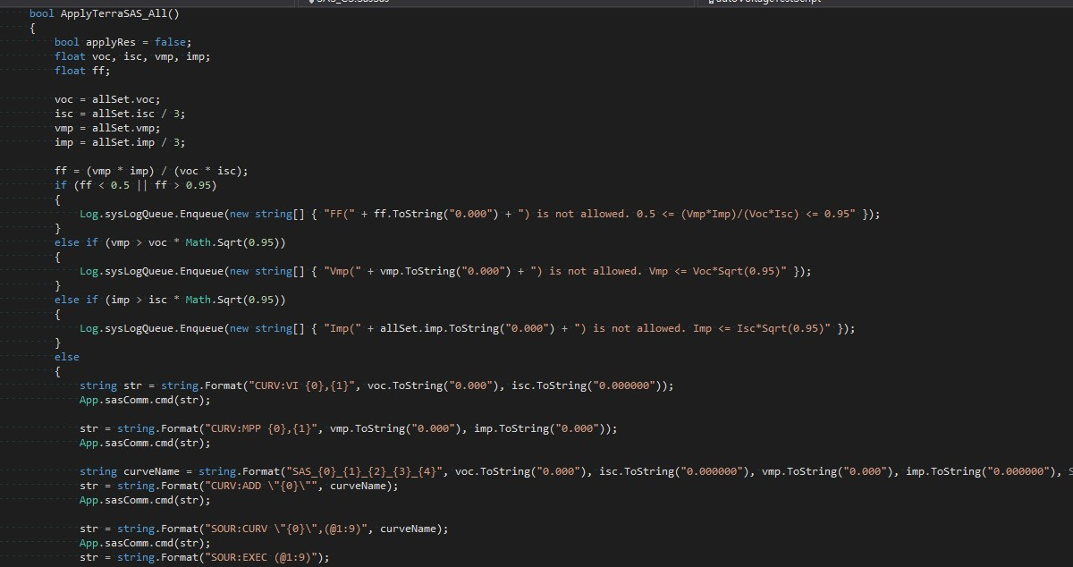
13. SasSas.cs

Slide 25
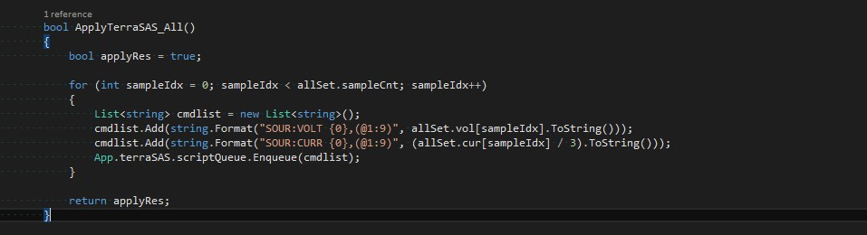
14. SasSpin.cs

Slide 26
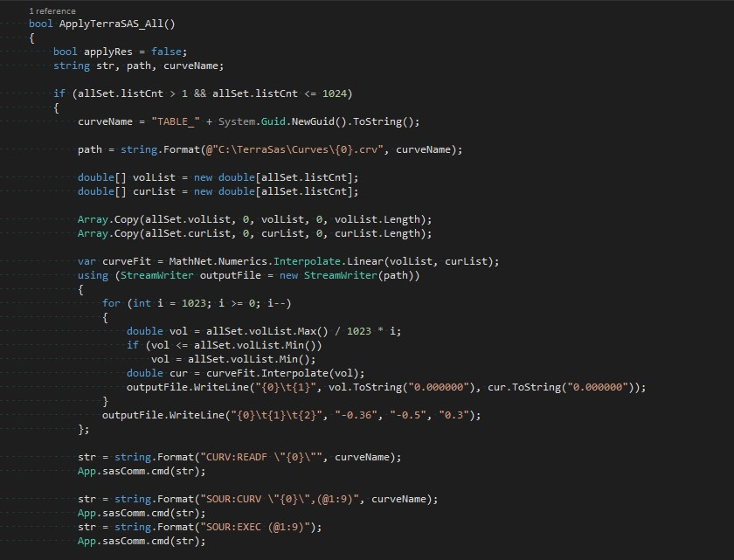
15. SasTable.cs

Slide 27
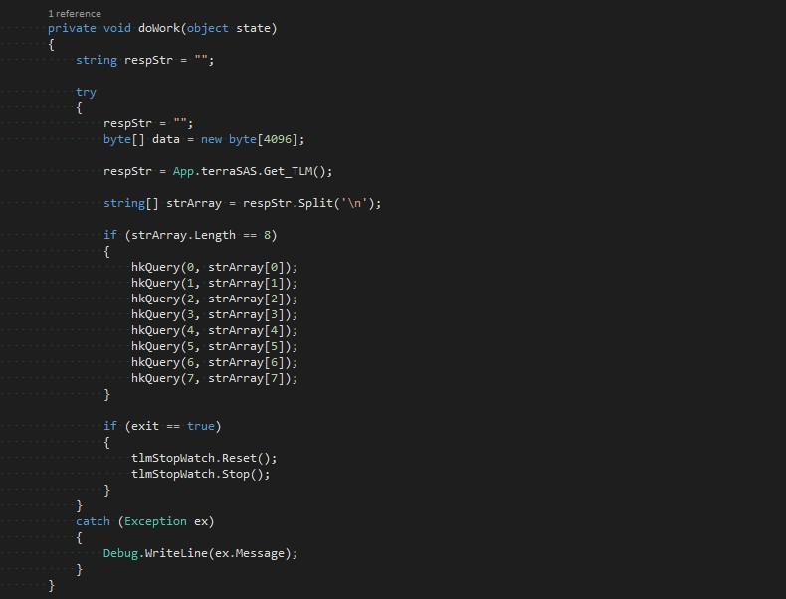
16. SasComm_TLM.cs

Slide 28
16. SasComm_TLM.cs
TerraSAS로 부터 TLM 수신
  respStr = App.terraSAS.Get_TLM();
TLM Decoding
  hkQuery(0, strArray[0]);

Slide 29
17. SasComm_TLM.cs

Slide 30
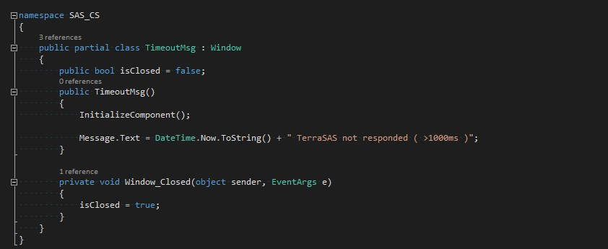
18. TimeoutMsg.cs

